Slide 1
Capstone Project Hotel Booking Analysis
Mohamed Anees

Slide 2
Points to Discuss :
• Agenda
• Data summary
• Univariate analysis
• Hotel wise analysis
• Distribution Channel wise analysis
• Booking cancellation analysis
• Time wise analysis
• Some important questions
• Correlation heat map
• Conclusion

Slide 3
Agenda
To discuss the analysis of given hotel bookings data set from 2015-2017.
We’ll be doing analysis of given data set in following ways :
Univariate analysis
Hotel wise analysis
Distribution Channel wise analysis
Booking cancellation analysis
Time wise analysis
By doing this we’ll try to find out key factors driving the hotel bookings trends.

Slide 4
Data Summary
Given data set has different columns of variables crucial for hotel bookings. Some of them are:
Hotel : The category of hotels, which are resort hotel and city hotel.
is_cancelled : The value of column show the cancellation type. If the booking was cancelled or not. Values[0,1], where 0 indicates not cancelled.
lead_time : The time between reservation and actual arrival.
stayed_in_weekend_nights : The number of weekend nights stay per reservation.
stayed_in_weekday_nights : The number of weekday nights stay per reservation.
Meal : Meal preferences per reservation.[BB,FB,HB,SC,Undefined]
Country : The original country of guest.

Slide 5
Data Summary(contd..)
market_segment: This column show how reservation was made and what is the purpose of reservation. E.g., corporate means corporate trip, TA for travel agency.
distribution_channel: The medium through booking was made.[Direct,Corporate,TA/TO,undefined,GDS.]
Is_repeated_guest: Shows if the guest is who has arrived earlier or not. Values[0,1]-->0 indicates no and 1 indicated yes person is repeated guest.
days_in_waiting_list: Number of days between actual booking and transact.
customer_type: Type of customers( Transient, group, etc.)

Slide 6
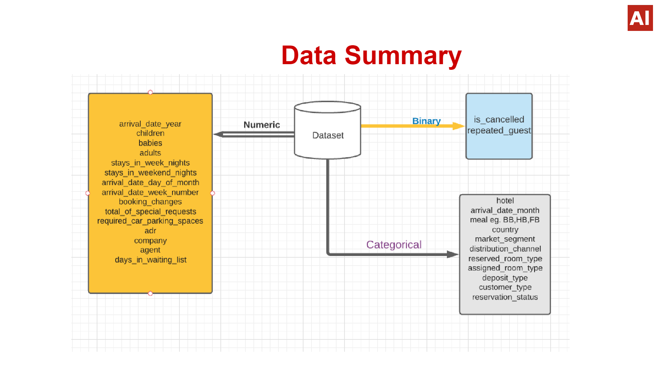
Data Summary

Slide 7
Univariate Analysis
While doing univariate analysis of given hotel booking dataset, we answered following questions:
(1) Which agent made most of bookings?
(2) Which room type is in most demand and which room type generates highest adr?
(3) From which country most of the customers are coming?
(4) What is the most preferred meal by customers?

Slide 8
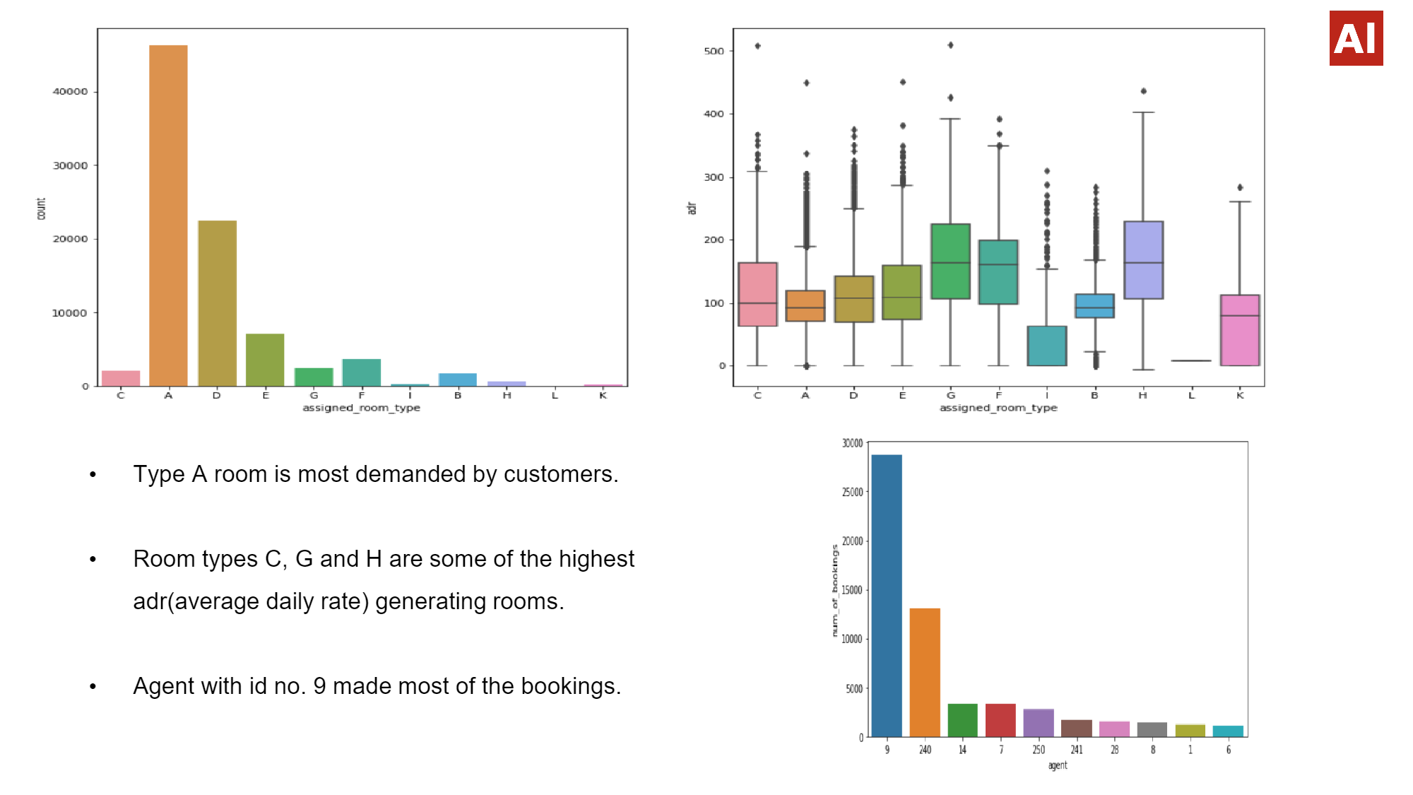

Slide 9
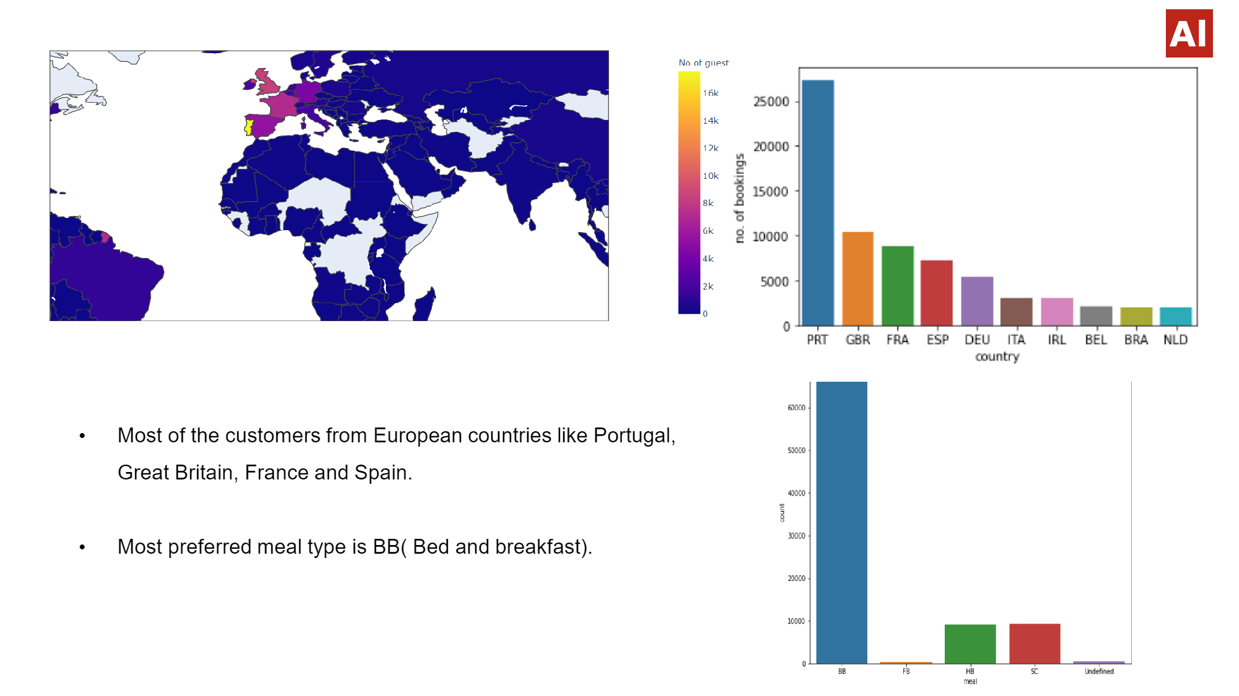

Slide 10
Hotel wise Analysis
While doing hotel-wise analysis of given hotel booking dataset, we answered following questions:
(1) Percentage of bookings in each hotels?
(2) Which hotel makes more revenue?
(3) Which hotel has higher lead time?
(4) What is most preferred stay length in each hotel?
(5) For which hotel, does people have to wait longer to get a booking confirmed?
(6) Which hotel has higher booking cancellations rate?
(7) Which hotel have higher and how much customer returning rate?

Slide 11
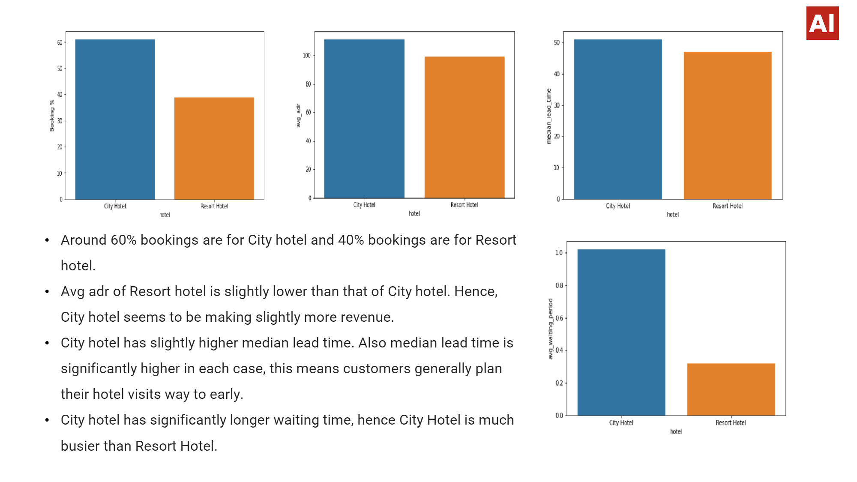

Slide 12
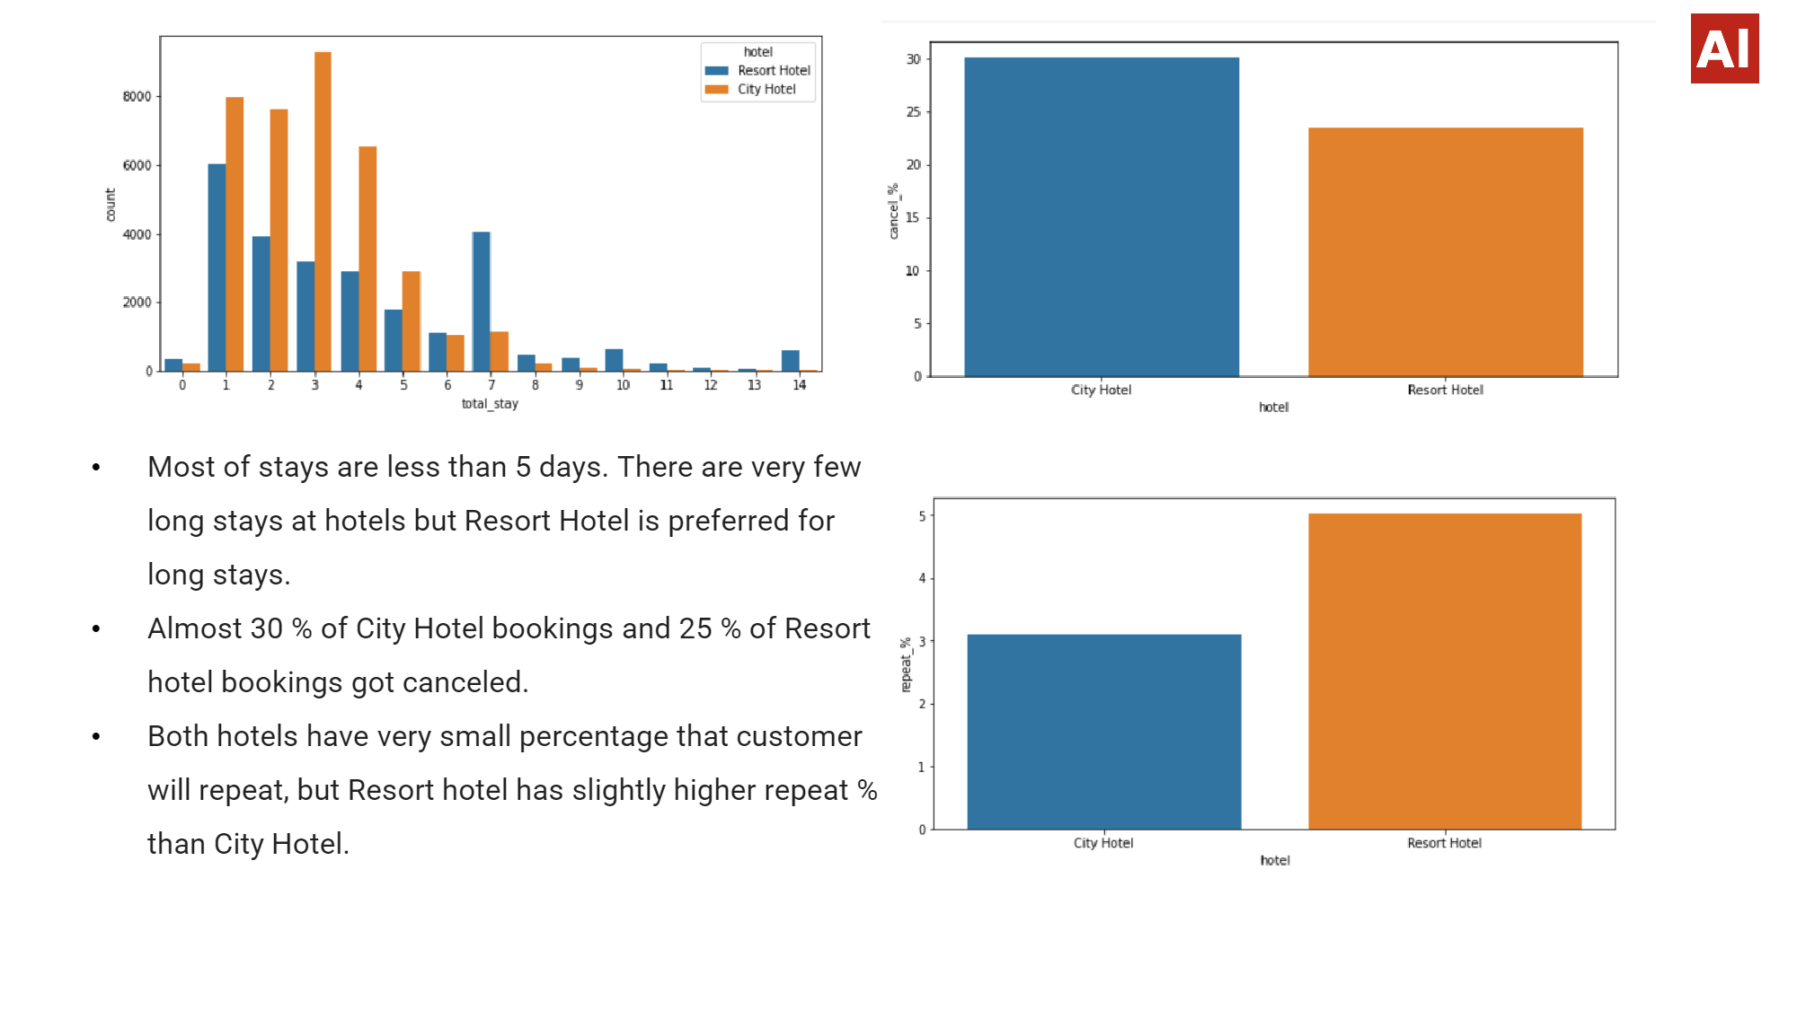

Slide 13
Distribution channel wise Analysis
While doing Distribution channel wise analysis of given hotel booking dataset, we answered following questions:
Which is the most common channel for booking hotels?
(2) Which channel is mostly used for early booking of hotels?
(3) Which distribution channel brings better revenue generating deals for hotels?

Slide 14
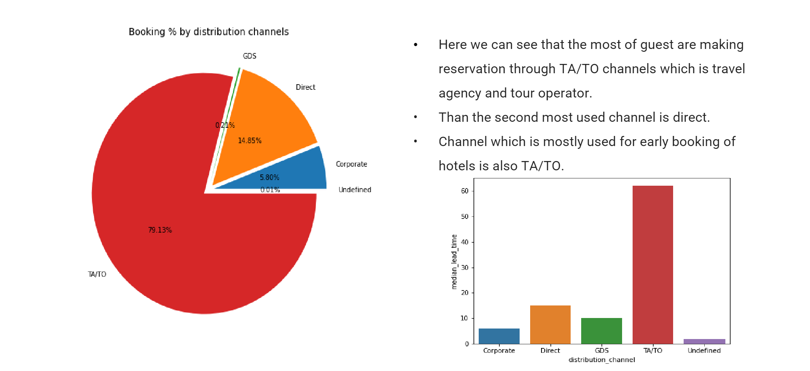
Distribution channel wise Analysis

Slide 15
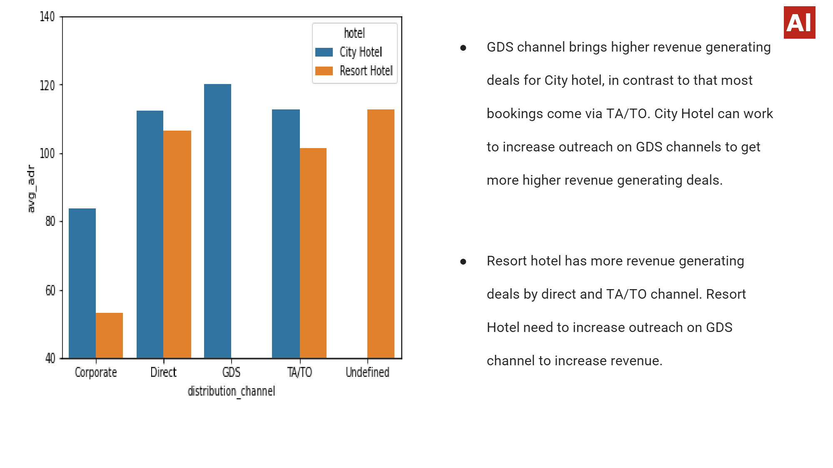

Slide 16
Booking cancellation Analysis
We will analyze the possible reasons for booking cancellations:
(1) Which significant distribution channel has highest cancellation percentage?
(2) Longer lead time.
(3) Longer time (in days) in waiting list.
(4) Not getting same room as reserved.
(5) Does not getting same room as reserved effects adr?

Slide 17
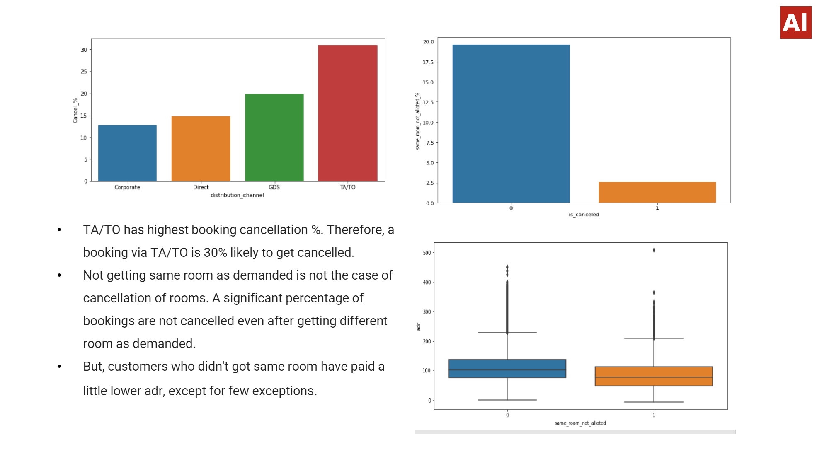

Slide 18
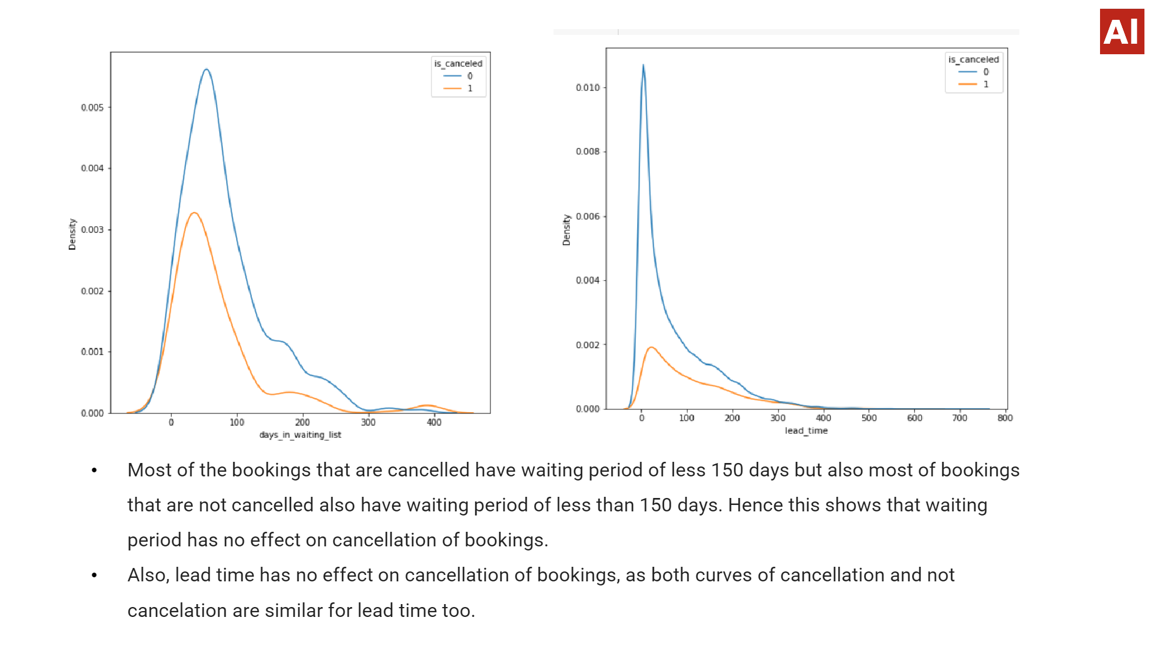

Slide 19
Time-wise Analysis
While doing time-wise analysis of given hotel booking dataset, we answered following questions:
(1 ) What are the most busy months for hotels?
(2) In which months hotels charges higher adr?
(3) How does booking numbers and adr changes within a month?
(4) How does bookings varies along year for different types of customers.

Slide 20
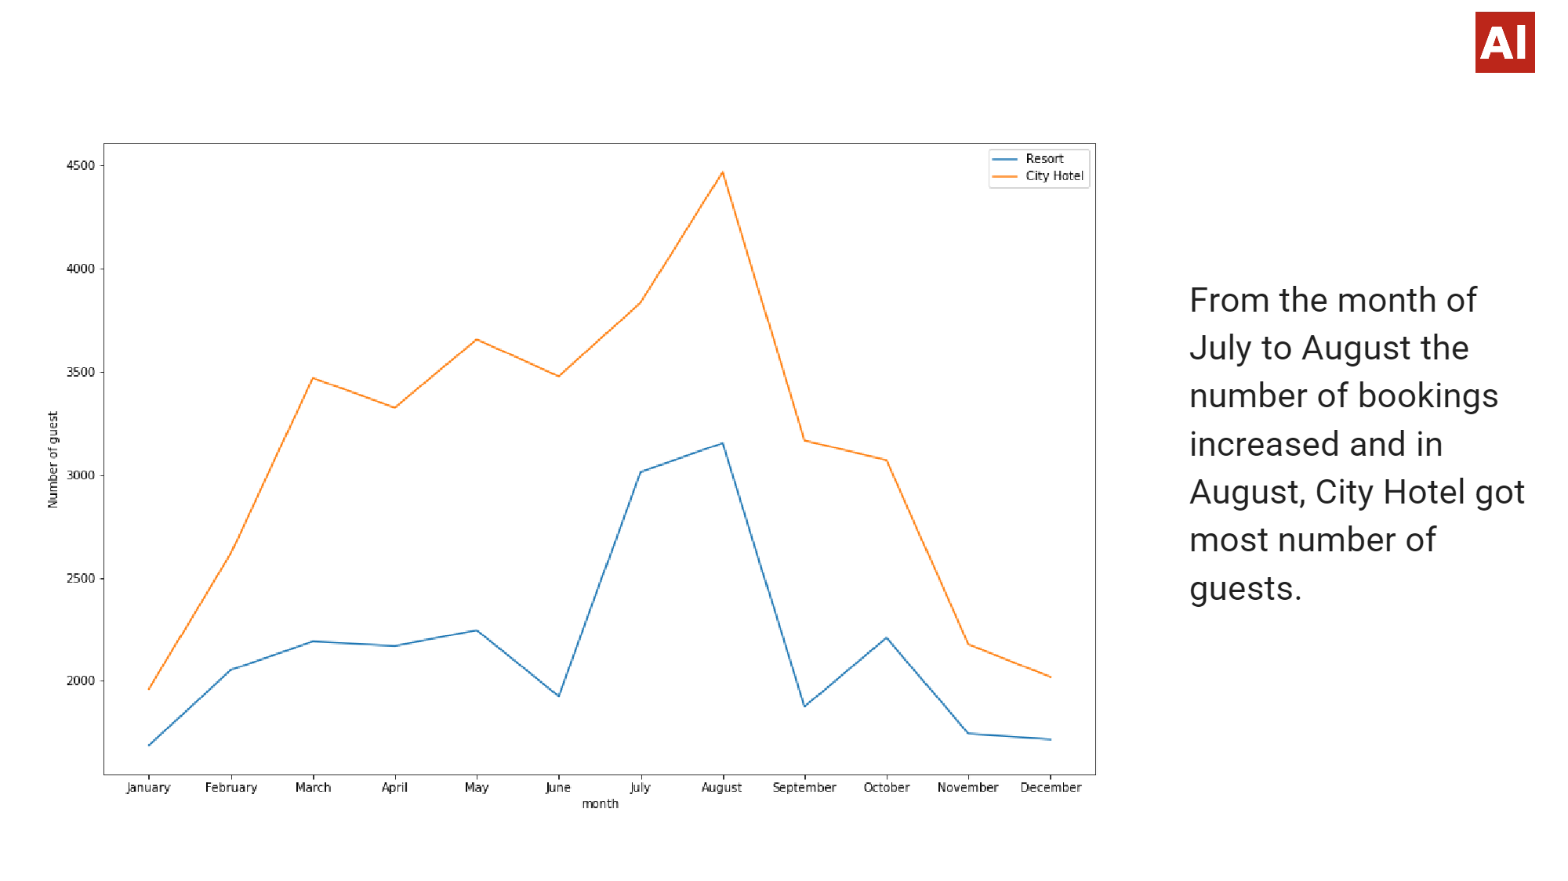

Slide 21
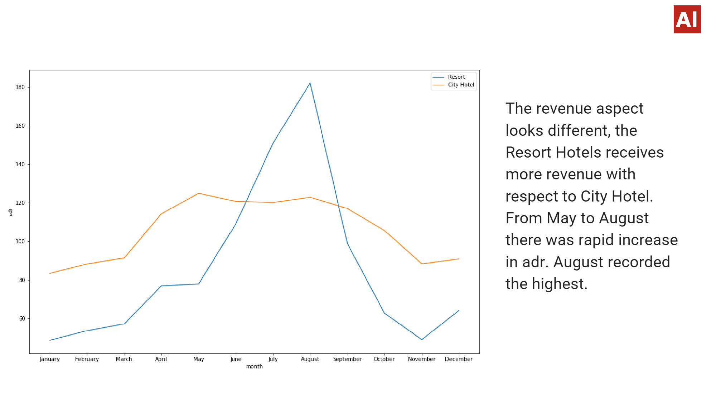

Slide 22
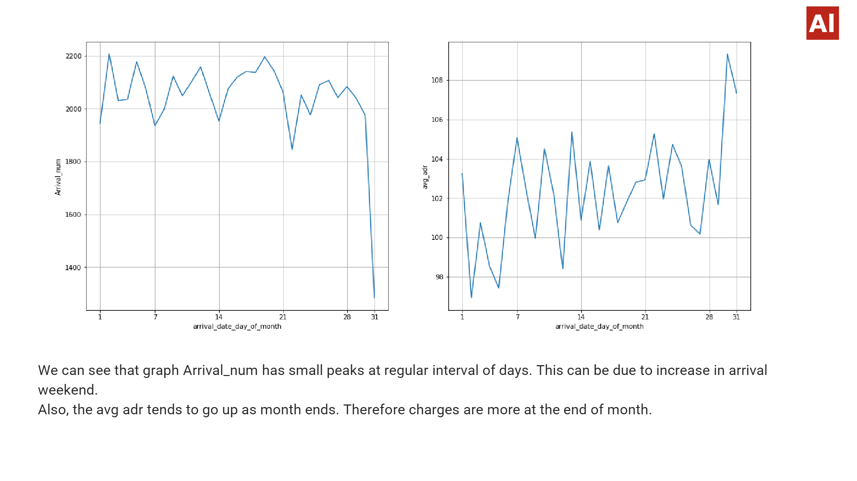

Slide 23
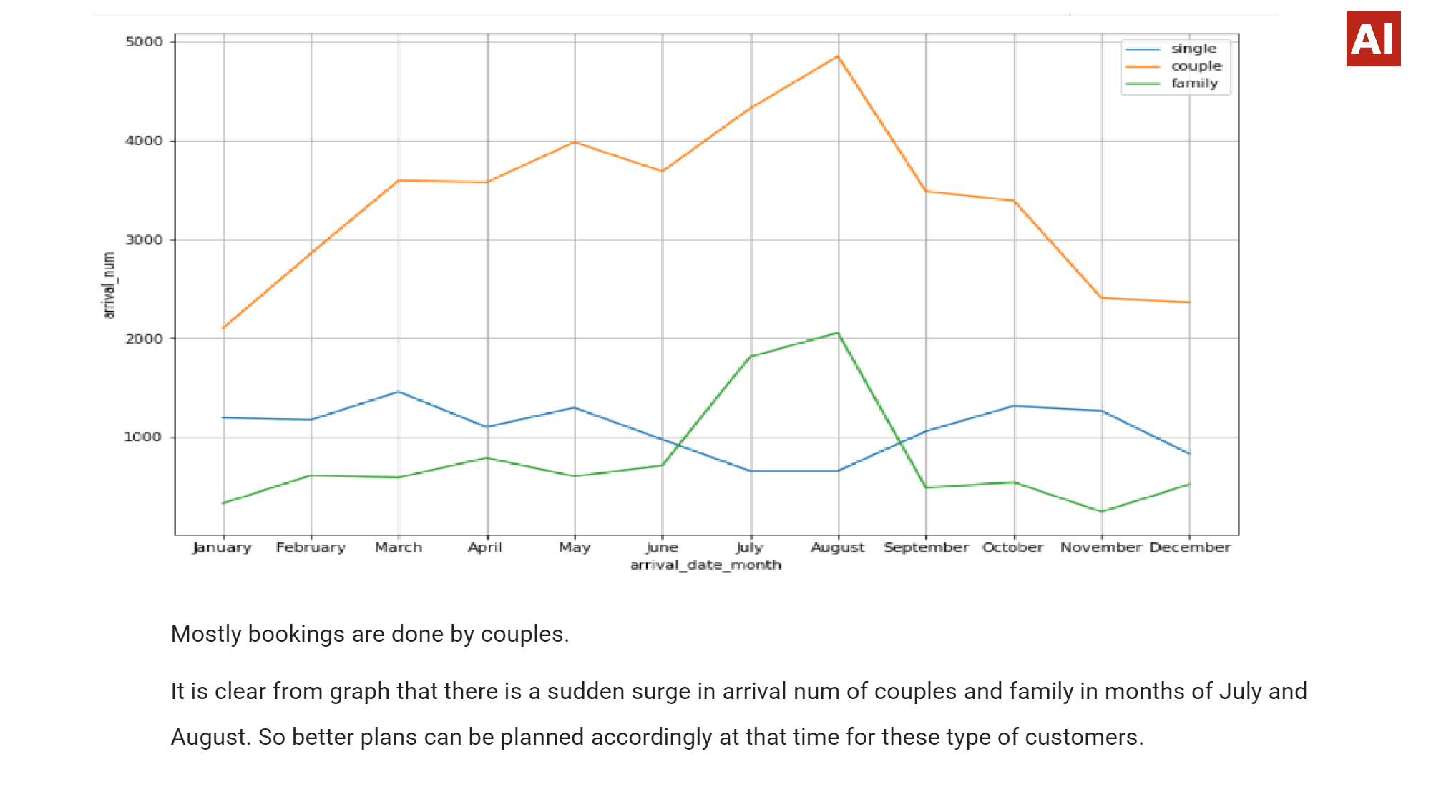

Slide 24
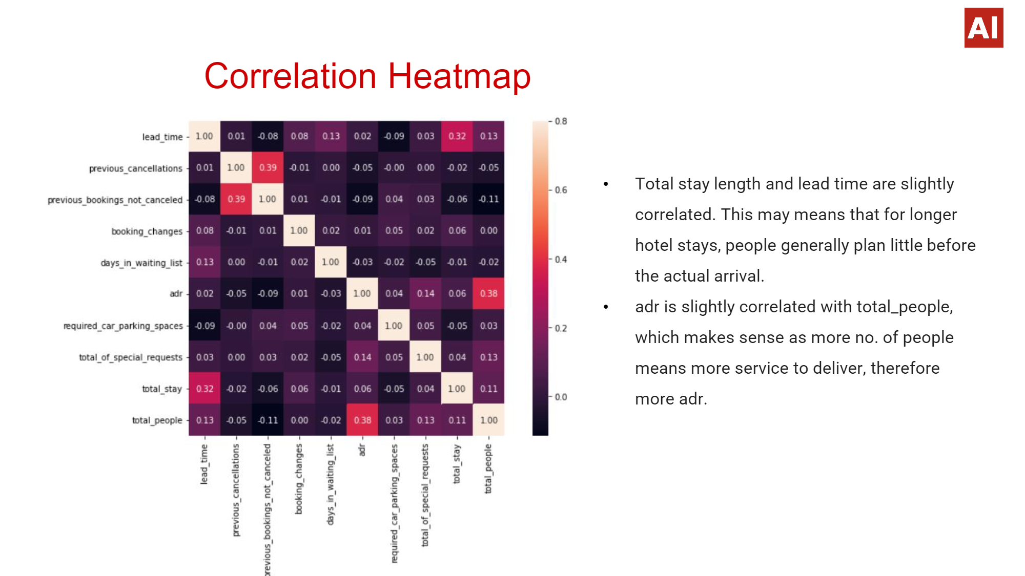

Slide 25
Conclusion
Around 60% bookings are for City hotel and 40% bookings are for Resort hotel, therefore City Hotel is busier than Resort hotel. Also the overall adr of City hotel is slightly higher than Resort hotel.
Mostly guests stay for less than 5 days in hotel and for longer stays Resort hotel is preferred.
Both hotels have significantly higher booking cancellation rates and very few guests less than 3 % return for another booking in City hotel. 5% guests return for stay in Resort hotel.
Most of the guests came from European countries, with most no. of guest coming from Portugal.
Guests use different channels for making bookings out of which most preferred way is TA/TO.
For hotels higher adr deals come via GDS channel, so hotels should increase their popularity on this channel.
Almost 30% of bookings via TA/TO are cancelled.

Slide 26
Conclusion(contd..)
Not getting same room as reserved, longer lead time and waiting time do not affect cancellation of bookings. Although different room allotment do lowers the adr.
July-August are the most busier and profitable months for both of hotels.
Within a month, adr gradually increases as month ends, with small sudden rise on weekends.
Couples are the most common guests for hotels, hence hotels can plan services according to couples needs to increase revenue.
More number of people in guests results in more number of special requests.
Bookings made via complementary market segment and adults have on average high no. of special request.
For customers, generally the longer stays (more than 15 days) can result in better deals in terms of low adr.

Slide 27
Thank You

